Slide 1
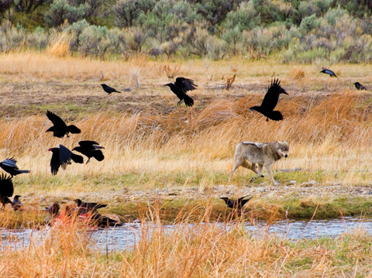
PORTFOLIO PROJECT
BIODIVERSITY IN US NATIONAL PARKS

Slide 2

INTRODUCTION
This project is focused on interpreting data from the National Parks Service about endangered species.
Main Tasks
Analyze several species of animals/plants
Check their conservation status (whether they are in danger of extinction or not)
Look how many weekly observations of them we have in 4 US National Parks

Slide 3
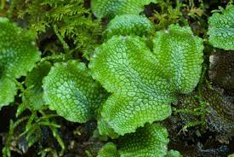
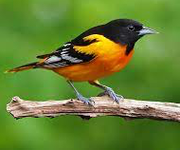
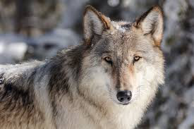
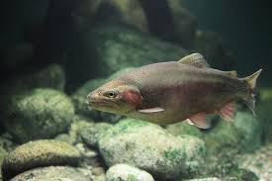



CATEGORIES
MAMMALS
NONVASCULAR PLANTS
FISHES
BIRDS
REPTILES
VASCULAR PLANTS
AMPHIBIANS

Slide 4
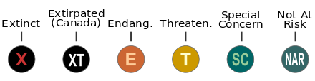
CONSERVATION STATUSES
Extinct
Threatened
Not At Risk (Safe)
Endangered
If a Species is improving its status, it is classified as “In Recovery”
Species of Concern

Slide 5

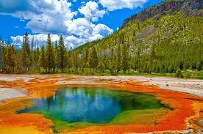


PARKS
YOSEMITE NATIONAL PARK
YELLOWSTONE NATIONAL PARK
GREAT SMOKY MOUNTAINS NATIONAL PARK
BRYCE NATIONAL PARK

Slide 6

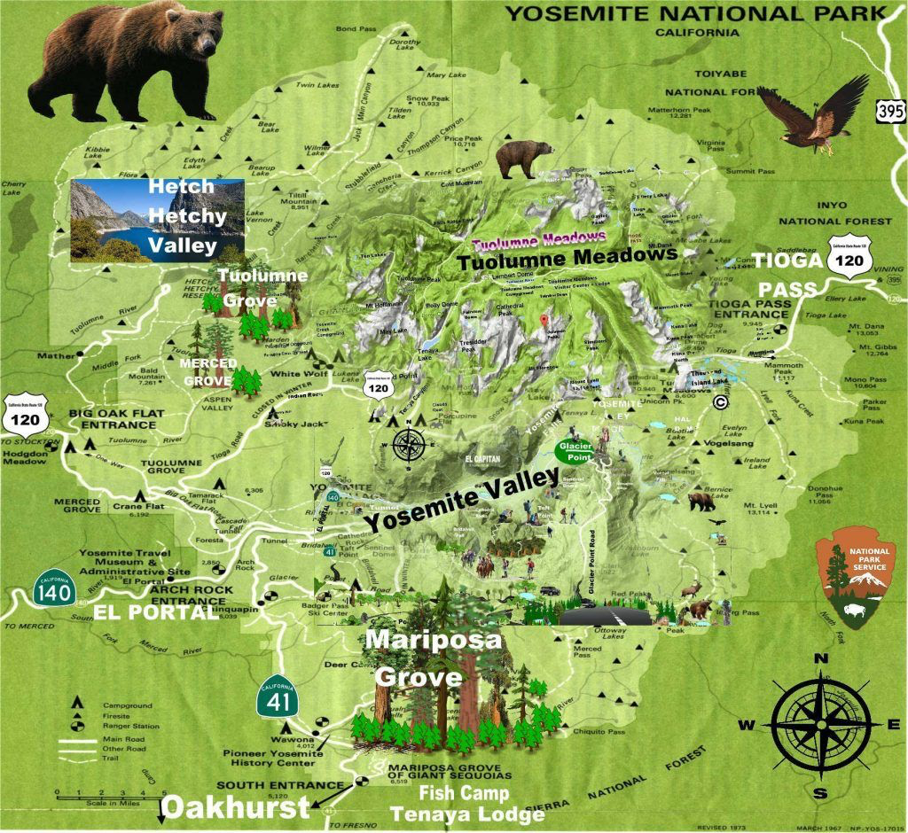


RESULTS

Slide 7
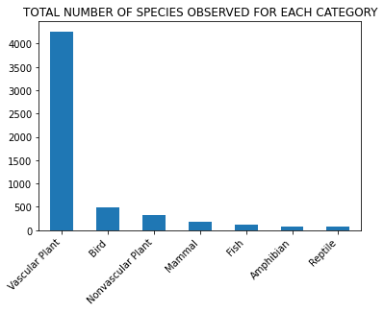
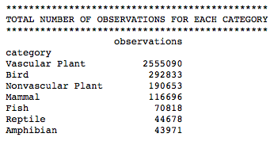
1 – Which category has the lowest observations? Which one the highest?

Slide 8
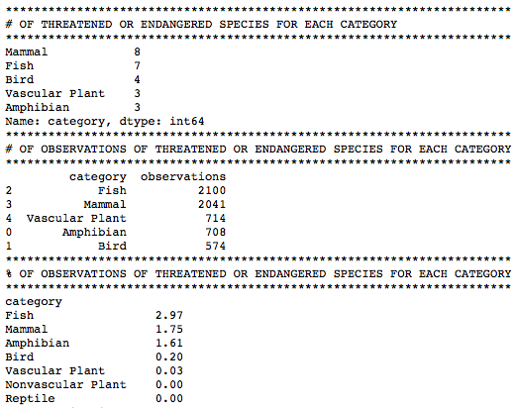
2 - Which category has the higher number of Endangered and Threatened species?

